Slide 1
Static Routing
Reach Remote Networks
A router can learn about remote networks in one of two ways:
Manually - Remote networks are manually entered into the route table using static routes.
Dynamically - Remote routes are automatically learned using a dynamic routing protocol.
Notes:
6.1.1.1 Reach Remote Networks

Slide 2
Static Routing
Why Use Static Routing?
Static routing provides some advantages over dynamic routing, including:
Static routes are not advertised over the network, resulting in better security.
Static routes use less bandwidth than dynamic routing protocols, no CPU cycles are used to calculate and communicate routes.
The path a static route uses to send data is known.
Notes:
6.1.1.2 Why Use Static Routing?

Slide 3
Static Routing
Why Use Static Routing? (cont.)
Static routing has the following disadvantages:
Initial configuration and maintenance is time-consuming.
Configuration is error-prone, especially in large networks.
Administrator intervention is required to maintain changing route information.
Does not scale well with growing networks; maintenance becomes cumbersome.
Requires complete knowledge of the whole network for proper implementation.
Notes:
6.1.1.2 Why Use Static Routing?

Slide 4
Static Routing
When to Use Static Routes
Static routing has three primary uses:
Providing ease of routing table maintenance in smaller networks that are not expected to grow significantly.
Routing to and from stub networks. A stub network is a network accessed by a single route, and the router has no other neighbors.
Using a single default route to represent a path to any network that does not have a more specific match with another route in the routing table. Default routes are used to send traffic to any destination beyond the next upstream router.
Notes:
6.1.1.3 When to Use Static Routes

Slide 5
Types of Static Routes
Static Route Applications
Static Routes are often used to:
Connect to a specific network.
Provide a Gateway of Last Resort for a stub network.
Reduce the number of routes advertised by summarizing several contiguous networks as one static route.
Create a backup route in case a primary route link fails.
Notes:
6.1.2.1 Static Route Applications

Slide 6
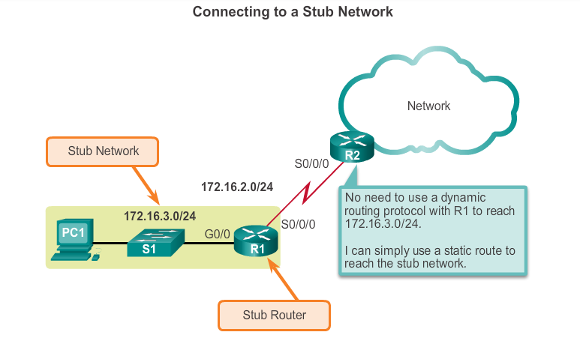
Types of Static Routes
Standard Static Route
Notes:
6.1.2.2 Standard Static Route

Slide 7
Types of Static Routes
Default Static Route
A default static route is a route that matches all packets.
A default route identifies the gateway IP address to which the router sends all IP packets that it does not have a learned or static route.
A default static route is simply a static route with 0.0.0.0/0 as the destination IPv4 address.
Notes:
6.1.2.3 Default Static Route

Slide 8
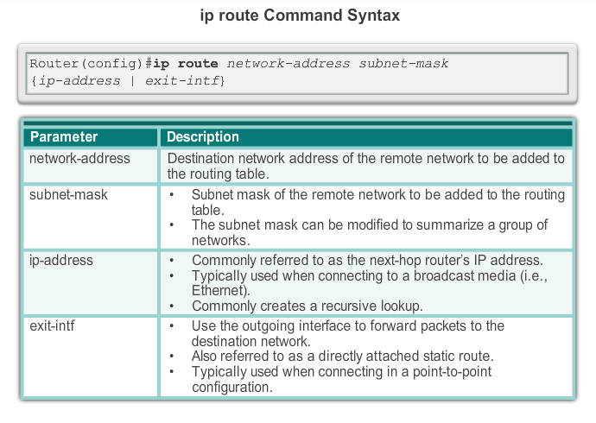
Configure IPv4 Static Routes ip route Command
Notes:
6.2.1.1 ip route Command

Slide 9
Configure IPv4 Static Routes
Next-Hop Options
The next hop can be identified by an IP address, exit interface, or both. How the destination is specified creates one of the three following route types:
Next-hop route - Only the next-hop IP address is specified.
Directly connected static route - Only the router exit interface is specified.
Fully specified static route - The next-hop IP address and exit interface are specified.
Notes:
6.2.1.2 Next-Hop Options

Slide 10
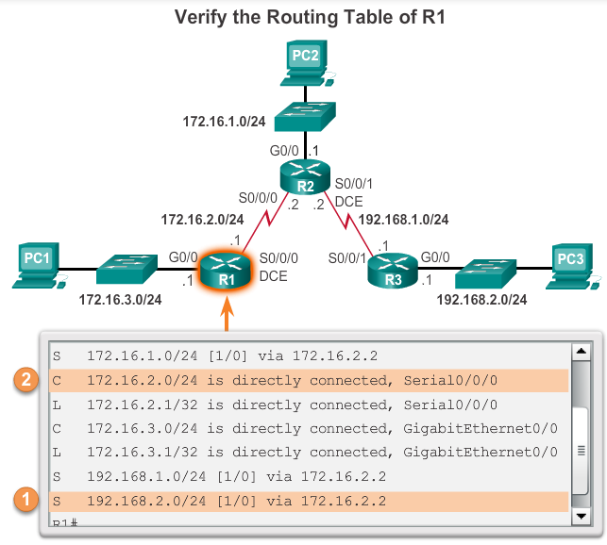
Configure IPv4 Static Routes
Configure a Next-Hop Static Route
When a packet is destined for the 192.168.2.0/24 network, R1:
1. Looks for a match in the routing table and finds that it has to forward the packets to the next-hop IPv4 address 172.16.2.2.
2. R1 must now determine how
to reach 172.16.2.2; therefore,
it searches a second time for a
172.16.2.2 match.
Notes:
6.2.1.3 Configure a Next-Hop Static Route

Slide 11
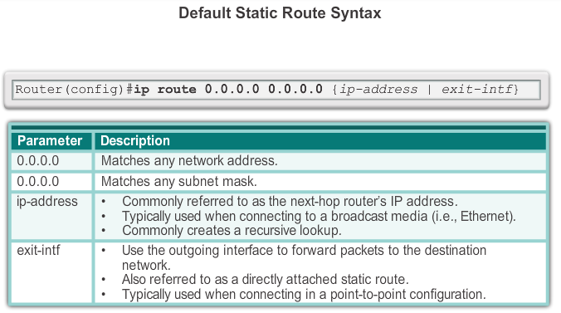
Configure IPv4 Default Routes
Default Static Route
Notes:
6.2.2.1 Default Static Route

Slide 12
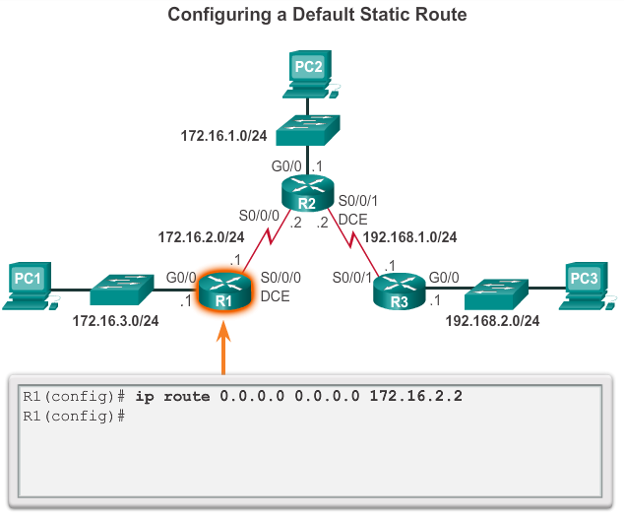
Configure IPv4 Default Routes
Configure a Default Static Route
Notes:
6.2.2.2 Configure a Default Static Route

